Slide 1
Intermediate Coding Week 15
More Sorting

Slide 2

Sorting Review
Notes:
Shopping basket was the best icon I could find for “sorting”… might not be the most appropriate.

Slide 3
Sorting
In coding, sorting is the process of arranging values in order, usually from smallest to largest.
Sorting is an important step of many algorithms, since many algorithms (such as binary search, which we looked at last week) work better when all the elements are in order.
Today, we will be looking at three basic types of sorting: selection sort, insertion sort, and bubble sort.
We will be performing sorting on arrays, just like we did for searching.
Notes:
There are many different kinds of sorting algorithms:
Some are faster than others.
Some use more memory (take up more space in the computer’s data) than others

Slide 4
Swapping values
You may have noticed that selection sort includes a step where we swap values. How can we do this?
Imagine we have two variables:
int a = 1;
int b = 2;

Slide 5
Incorrect swap
We might try to swap them by setting them equal to each other:
a = b;
b = a;
But this won’t work because when we set a = b, if we try to set b = a afterwards, a will already be equal to b so b will not change, and we will only have set both variables to the value of b.

Slide 6
Correct swap
Instead, we will need to introduce a temporary value to help us deal with the swap.
int temp = a;
a = b;
b = temp;
This means that we can preserve the value of a in temp so we don’t lose it when we set a = b.

Slide 7
Correct swap (fish tanks)
We can actually swap without using a temp variable.
int a, b;
a += b;
b = a-b;
a-=b;
Why does this work? (Hint: try this with a = 5 and b= 3).

Slide 8
Selection Sort
Orders a list of values by repeatedly putting the smallest or largest unsorted value into its final position.
The algorithm:
Look through the list to find the smallest value.
Swap it so that it is at index 0.
Look through the list to find the second-smallest value.
Swap it so that it is at index 1.
…
Repeat until all values are in their proper places.

Slide 9
Video visualizations of Selection Sort
In the same vein as the flamenco dance searching videos, here is a video involving selection sort and dancing:
https://www.youtube.com/watch?v=Ns4TPTC8whw
If you would like a quicker and less dance-filled visualization, here is a shorter video:
https://www.youtube.com/watch?v=92BfuxHn2XE
Notes:
Note that these videos use slightly different variations on selection sort. Can you tell the difference?
Difference between the videos: one swaps the current minimum value with the value in the array we are looking at while the other only keeps track of the minimum value.

Slide 10
Insertion Sort
Shifts each value into a sorted subarray at the beginning of the array.
The algorithm:
The first element starts out in the “sorted subarray”.
Consider the second element: if it is smaller than the first element, swap it with the first element. Otherwise, leave it in its original position. The “sorted subarray” now has two elements.
Consider the third element: if it is smaller than the second element of the sorted subarray, swap it with the second element. If it was swapped, compare it to the first element and swap them if the first element is smaller. The “sorted subarray” now has three elements.
Continue adding elements to the “sorted subarray” in this manner until all the elements are in the “sorted subarray”.

Slide 11
Insertion Sort With Cards
You can often think of insertion sort as how you might sort a hand of cards.
That is, when people are sorting a hand of cards, they often will consider each card at a time, placing it into its correct place in the “sorted” section of the hand.
Try it yourself on cards!

Slide 12
Video visualization of Insertion Sort
Here’s a dance related video with Romanian folk dance:
https://www.youtube.com/watch?v=ROalU379l3U
And here’s a faster video with bars:
https://www.youtube.com/watch?v=8oJS1BMKE64

Slide 13
Bubble Sort
Make repeated passes, swapping adjacent values.
Called “Bubble Sort” because of how quickly large elements tend to “bubble up” to the end of the array.
The algorithm:
Pass 1:
Consider the first and second elements. If the second is smaller than the first, swap them.
Consider the second and third elements (now that the first two are swapped). If the third is smaller than the second, swap them.
Repeat until you reach the end of the array.
Continue making passes across the array until you perform a pass in which no element changes its position.

Slide 14
Video visualization of Bubble Sort
A dance-related video with Hungarian folk dance. Sorting starts at time 0:53.
https://www.youtube.com/watch?v=lyZQPjUT5B4
The shorter version:
https://www.youtube.com/watch?v=Cq7SMsQBEUw

Slide 15
Merge Sort
Notes:
Shopping basket was the best icon I could find for “sorting”… might not be the most appropriate.

Slide 16
Merge Sort
merge sort: Repeatedly divides the data in half, sorts each half, and combines the sorted halves into a sorted whole.
The algorithm:
Divide the list into two roughly equal halves.
Sort the left half.
Sort the right half.
Merge the two sorted halves into one sorted list.

Slide 17
Merge sort example
index | 0 | 1 | 2 | 3 | 4 | 5 | 6 | 7
value | 22 | 18 | 12 | -4 | 58 | 7 | 31 | 42
split
22 | 18 | 12 | -4
58 | 7 | 31 | 42
split
split
22 | 18
12 | -4
58 | 7
31 | 42
split
split
split
split
22
18
12
-4
58
7
31
42
merge
merge
merge
merge
18 | 22
-4 | 12
7 | 58
31 | 42
merge
merge
-4 | 12 | 18 | 22
7 | 31 | 42 | 58
merge
-4 | 7 | 12 | 18 | 22 | 31 | 42 | 58

Slide 18
Merge Sort video!
https://www.youtube.com/watch?v=XaqR3G_NVoo

Slide 19
Quick Sort
Notes:
Shopping basket was the best icon I could find for “sorting”… might not be the most appropriate.

Slide 20
Quicksort
quicksort: Repeatedly picks an element, partitions the remaining elements into two-subarrays depending on whether they are less than or greater than the pivot, and sorts the subarrays recursively.
Like merge sort, quicksort is a divide-and-conquer algorithm.
This is the sorting algorithm most computers use (Arrays.sort(arr))
The algorithm:
Randomly pick an element (called the pivot).
Swap the elements so that all the elements to the left of the pivot are less than the pivot and all the elements of the right of the pivot are larger than the pivot (called a partition).
Recursively perform quicksort on the subarray to the left of the pivot and the subarray to the right of the pivot.

Slide 21
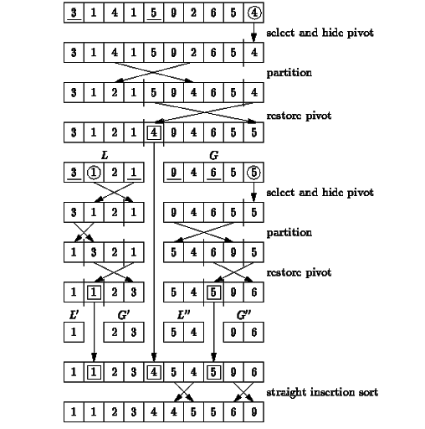
Quicksort example

Slide 22
Quicksort video!
https://www.youtube.com/watch?v=ywWBy6J5gz8

Slide 23
15 Sorting Algorithms Video
https://www.youtube.com/watch?v=kPRA0W1kECg

Slide 24

Problems

Slide 25
Question 1
Write a program to implement bubble sort on an array.
Remember to implement code swaps correctly!

Slide 26
Question 2
Given an unsorted array, perform one of the sorting algorithms we learned in class today on the array, and then implement binary search on the array now that it’s sorted.

Slide 27
Question 3
Given an unsorted array, use one of the sorting algorithms we learned in class today to order the values from largest to smallest (rather than smallest to largest like we were doing in class).

Slide 28

These problems will need recursion, try them please

Slide 29
Question 1 (A Challenge!)
(This question might be a little tricky! So, you can skip to question 2 if it’s too difficult)
Try to implement Quicksort! I know we didn’t spend much time going over the algorithm, so this question might take some research and/or individual thinking about how exactly to programmatically implement Quicksort.
If you have any questions or want me to look over your attempts, feel free to email me!

Slide 30
Question 2
Now that you know so many types of sorts, pick one you like and use it to sort an array of lowercase letters!
(Try not to use Arrays.sort(arr): challenge yourself!)
You can compare characters in Java—a character that comes before in the alphabet will be “less than” a character that comes later. For example, ‘a’ < ‘d’.

